Slide 1
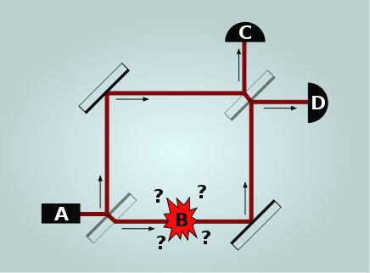
Quantum Bomb Tester
Elitzur–Vaidman in 1993
https://en.wikipedia.org/wiki/Elitzur%E2%80%93Vaidman_bomb_tester

Slide 2
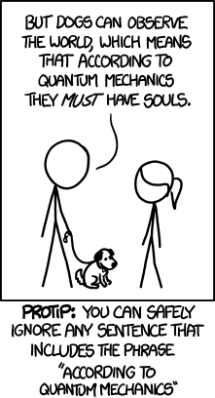
https://xkcd.com/1240/

Slide 3
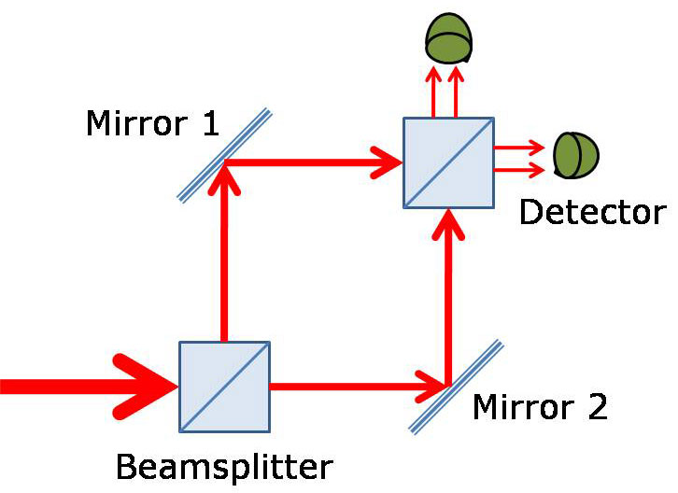
Mach–Zehnder interferometer
https://physics.stackexchange.com/questions/274379/outcome-of-mach-zehnder-interferometer-experiment

Slide 4
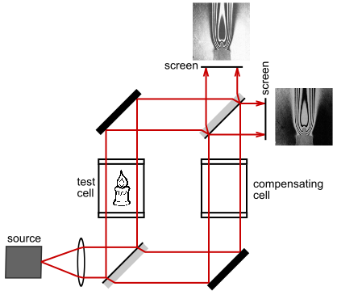
In physics, the Mach–Zehnder interferometer is a device used to determine the relative phase shift variations between two collimated beams derived by splitting light from a single source.
https://en.wikipedia.org/wiki/Mach%E2%80%93Zehnder_interferometer

Slide 5
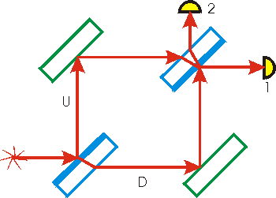
The index of refraction of a perfect mirror can be thought of as infinite. Thus light reflected by a mirror has its phase changed by one half a wavelength.
When a light ray is incident on a surface and the material on the other side of the surface has a lower index of refraction, the reflected light ray does not have its phase changed.
∏ shift / 180’
https://faraday.physics.utoronto.ca/PVB/Harrison/MachZehnder/MachZehnder.html

Slide 6
Live bomb
Dud bomb

Slide 7
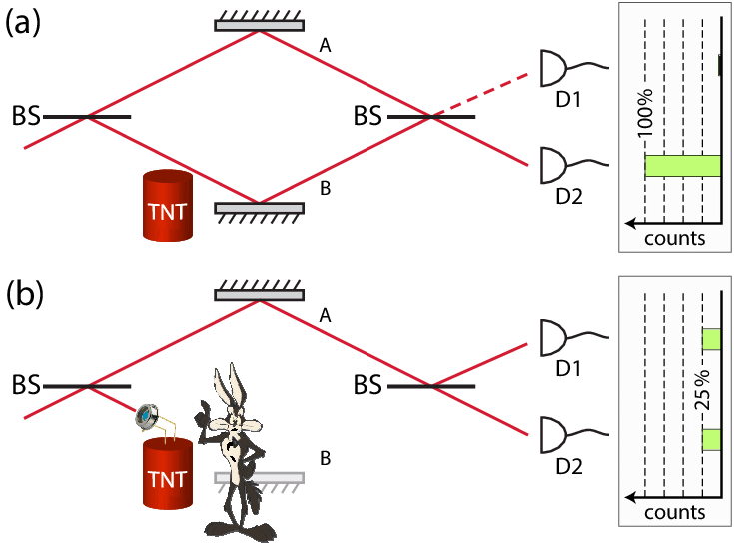
D2
D1
D2
D1
https://www.researchgate.net/figure/Bomb-testing-with-a-Mach-Zehnder-interferometer-operated-with-a-single-photon-at-a-time_fig1_308361661

Slide 8
With a dud, the photon will always arrive at Detector D1.
D2
D1
D2
D1

Slide 9
With a live bomb, there can be three possible outcomes:
No photon was detected (50% chance), the bomb exploded.
The photon was detected at D1 (25% chance).
The photon was detected at D2 (25% chance).
D2
D1
D2
D1

Slide 10
If the result is D1, the experiment is repeated. If the photon continues to be observed at D1 and the bomb doesn't explode, it can eventually be concluded that the bomb is a dud.^{[8]}
With this process 25% of live bombs can be identified without being detonated (D2), 50% will be detonated and 25% remain uncertain (D1).^{[8]} By repeating the process with the uncertain ones, the ratio of identified non-detonated live bombs approaches 33% of the initial population of bombs

Slide 11
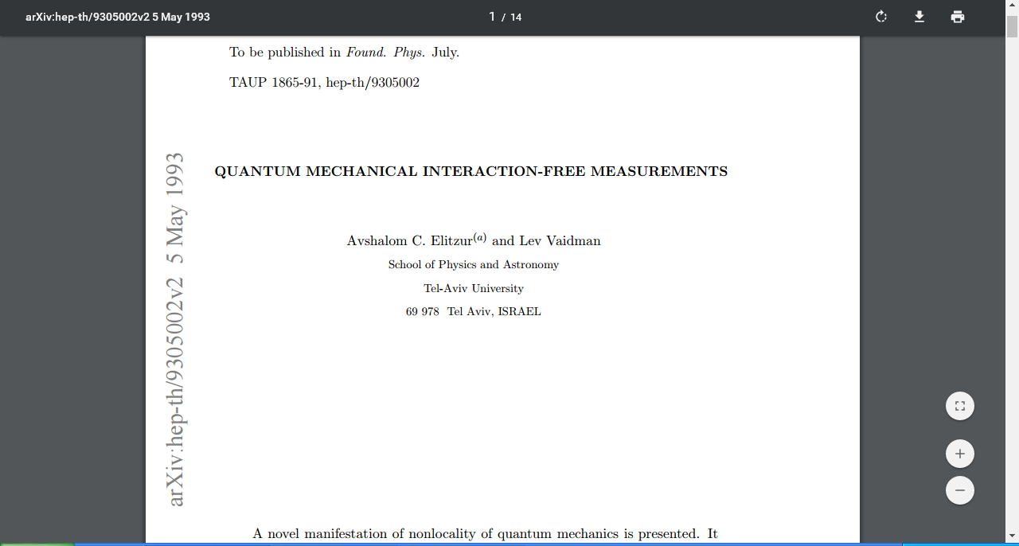
https://arxiv.org/pdf/hep-th/9305002.pdf

Slide 12
https://www.st-andrews.ac.uk/physics/quvis/simulations_html5/sims/QuantumBombGame/Quantum_bomb.html

Slide 13
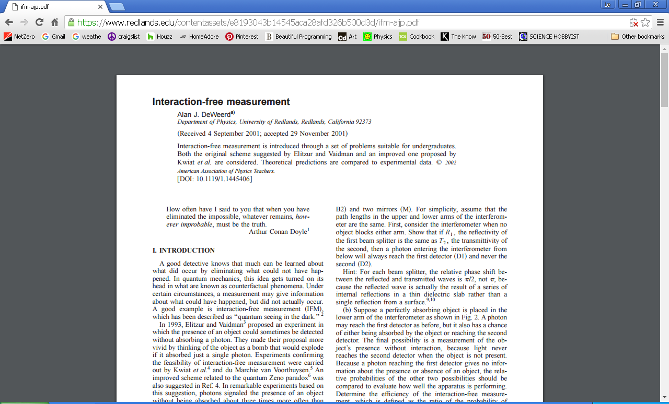
https://arxiv.org/pdf/hep-th/9305002.pdf

Slide 14
https://www.redlands.edu/contentassets/e8193043b14545aca28afd326b500d3d/ifm-ajp.pdf

Slide 15
https://www.redlands.edu/contentassets/e8193043b14545aca28afd326b500d3d/ifm-ajp.pdf

Slide 16
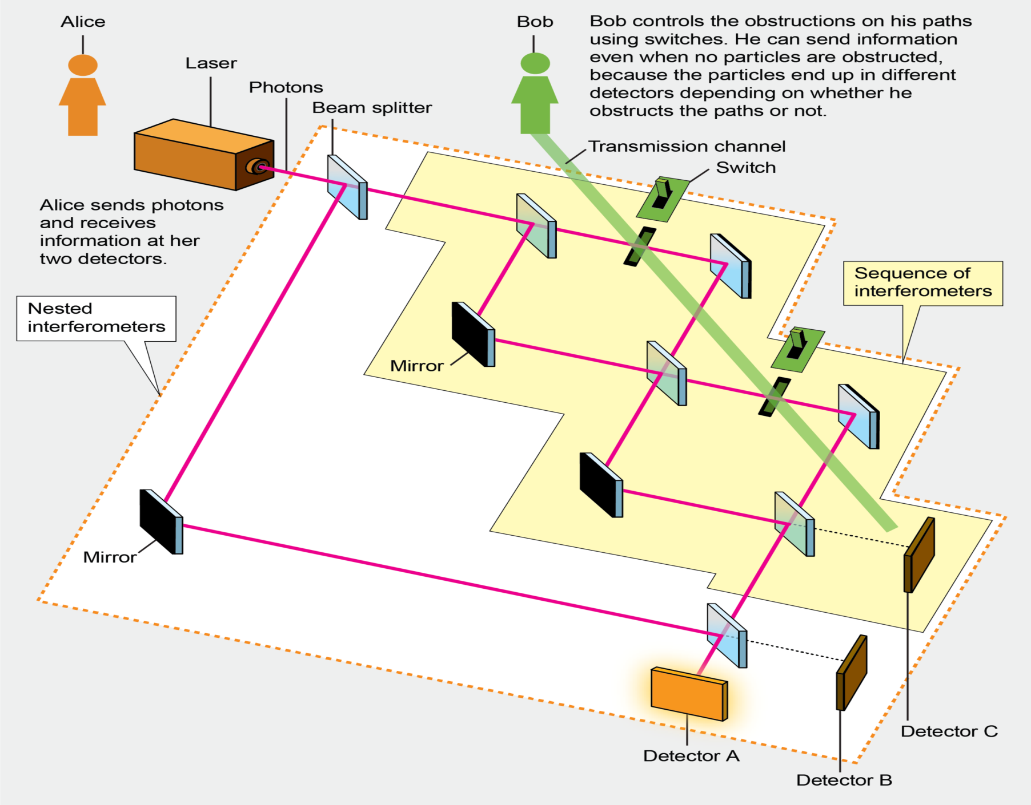
https://www.scientificamerican.com/article/nil-communication-how-to-send-a-message-without-sending-anything-at-all/

Slide 17
Counterfactual communication
“Direct counterfactual communication via quantum Zeno effect,” By Yuan Cao et al., PNAS, No. 19, May 9, 2017

Slide 18
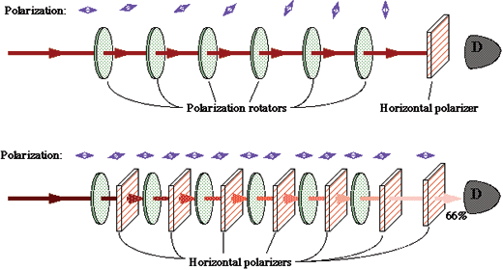
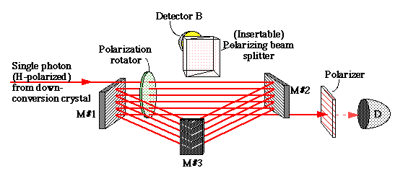
https://physics.illinois.edu/people/Kwiat/Interaction-Free-Measurements.htm

Slide 19
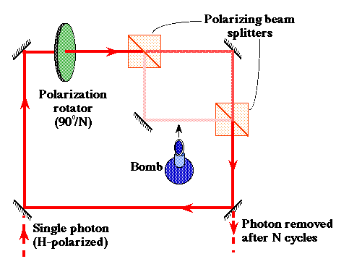
Transmit horizontal and reflect vertical polarized light
Any incident light is split into the horizontal and vertical components which are then added up again to reform the original polarization state.
If we have an object in the lower path, then the evolution is totally different. Again taking the case of N=6 for concreteness, during the first cycle there is only a 6.7% chance that the photon takes the lower path (and is absorbed). If this does not happen, then the photon wavefunction is "collapsed" into the upper path -- the photon is again completely horizontally polarized.
https://physics.illinois.edu/people/Kwiat/Interaction-Free-Measurements.htm

Slide 20
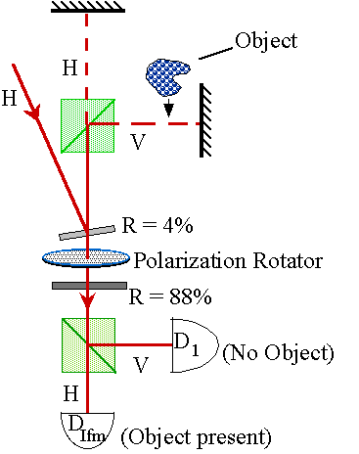
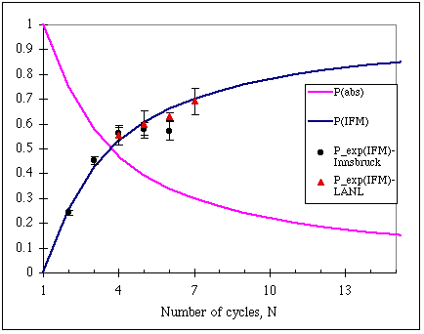
https://physics.illinois.edu/people/Kwiat/Interaction-Free-Measurements.htm

Slide 21
https://physics.aps.org/featured-article-pdf/10.1103/PhysRevLett.111.240402

Slide 22
https://physics.aps.org/featured-article-pdf/10.1103/PhysRevLett.111.240402

Slide 23
https://physics.aps.org/featured-article-pdf/10.1103/PhysRevLett.111.240402

Slide 24
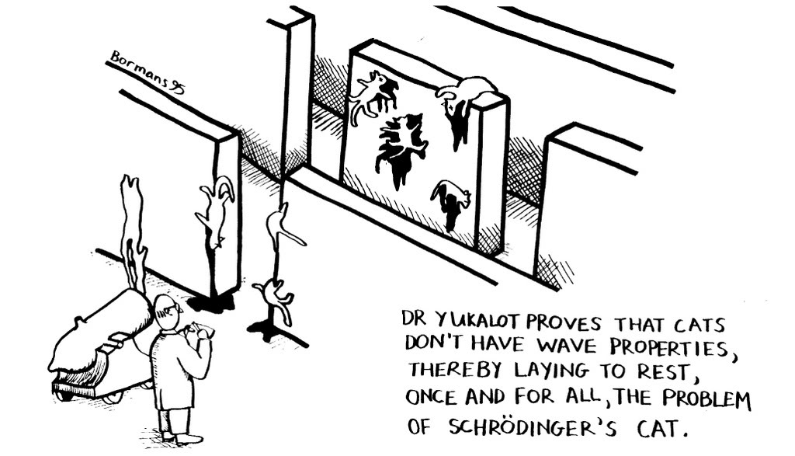
http://forums.atomicmpc.com.au/index.php/topic/9915-cool-quantum-mechanics-experiments/

